Slide 1
Software Engineering
Software process models
Notes:
Hello, I am Tomas Blažauskas from Kaunas University of Technology, Software Engineering Department. In this video i‘m going to present the software process models.

Slide 2
Topics of this lecture
The software process: activities
The software process: roles
The software process: artifacts
The software process: order of activities
The software process: the flow of activities
The software process model
Common software process models
Key points
Notes:
For the effective software development we need to use a proven and successful way of creating a software. It means – we need a description of the software creation process. That description is called software process model. In this video we will present the integral parts of software process model description such as activities, roles, artifacts and the overall idea of the software process model.

Slide 3






The software process: activities
Project management
Quality
management
Design
Evolution
Requirement
Specification
Configuration management
Process improvement
Construction
Validation
Notes:
A structured set of activities required to develop a software system.
Many different software processes but all involve:
Specification of the requirements– defining what the system should do;
Design – defining the organization of the system
Construction or Implementation - implementing the system;
Validation – checking that it does what the customer wants;
Evolution – changing the system in response to changing customer needs.
Beside these generic activities there are many more activities like:
Project management
Configuration management
Quality management
Process improvement
A software process model is an abstract representation of a process. It presents a description of a process from some particular perspective.

Slide 4

The software process: roles
Hello, I am a product owner!
Hi, I am a scrum master!
Hi, I am a software architect! I belong to a development team.
Hi, I am a programmer! I belong to a development team.
Notes:
All of the software process activities are performed by the persons who play a specific role in a software development process. Depending on a process - one person might play several roles.
In this example we have pictured the roles of the Scrum process. Alice is the product owner. She wants her product to be the right one therefore she will work a lot on specification of the requirements. The scrum master will supervise the team work - he will ensure that the activities of the software process are performed correctly. Karolis is a software architect therefore he will participate a lot in a design activities. Tomas is a programmer. He loves coding - implementing software features. So - he will mostly participate in software construction activities. On the other hand Tomas needs to be aware of other activities so he can construct the right product. Therefore he participates more or less in other activities as well.

Slide 5
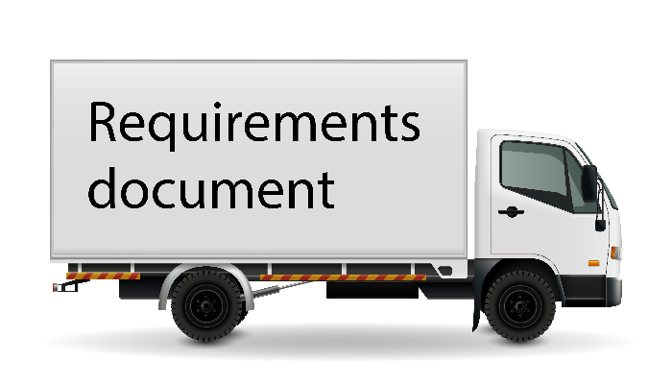
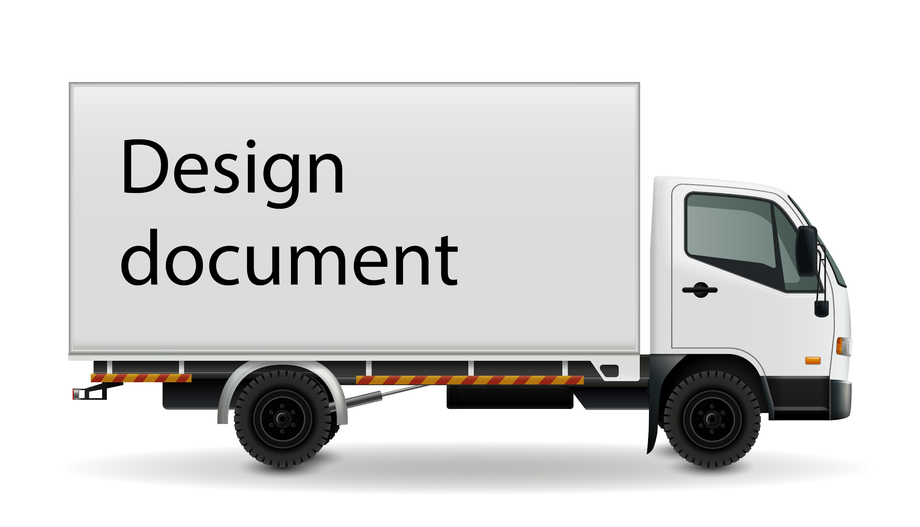


The software process: artifacts
Design
Construction
Validation
Notes:
The software process artifacts are the work products which are both: input necessary for some activities to start and output generated by the activity.
In this example we have three factories which represent appropriate activities: design factory represents design activities, construction factory represents implementation activities and validation factory represents validation activities.
In order for the design factory to produce some work products it is necessary to provide the requirements. After it is done, the design factory generates the design documents which are provided to the construction factory. In the construction factory the software is being created. This factory generates a lot of work products and the code normally is the most important work. product. The code is provided to validation factory which checks the code and creates the bug report document.

Slide 6
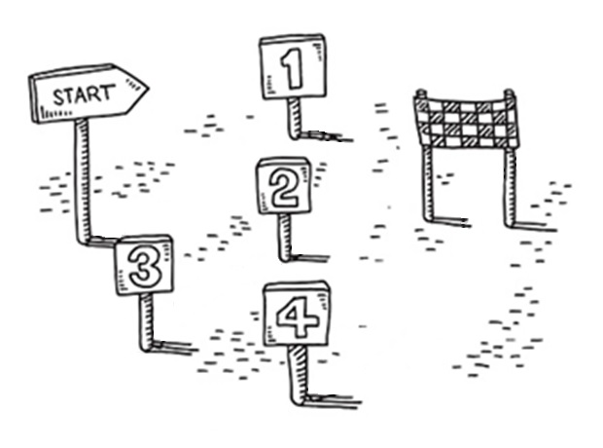
The software process: the order of activities
Notes:
At this point we know that a software process includes the activities, roles, artefacts. Still, these things do not describe the dynamics or the behavior of the software process model. The important task is to determine and describe the order in which activities are performed. Which activities need to be completed first so that the other activities could be started.

Slide 7
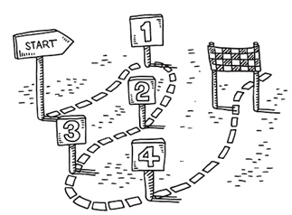
The software process: the order of activities
Notes:
At this point we know that a software process includes the activities, roles, artefacts. Still, these things do not describe the dynamics or the behavior of the software process model. The important task is to determine and describe the order in which activities are performed. Which activities need to be completed first so that the other activities could be started.

Slide 8
The flow of activities - linear style
Design
Construction
Validation
Notes:
Beside the order of activities we need to determine a flow of these activities. Until now we show examples which realised a linear flow. Each new activity starts after previous one is completed. This flow depicts the notorious “Waterfall” model which is not the most efficient model in many cases.

Slide 9
The flow of activities - iterative style
Iteration 1
Design
Construction
Validation
Evolution
Iteration 2
Design
Construction
Validation
Iteration n
Notes:
This flow depicts an iterative style. The development of the product is split into multiple iterations. Each iteration implements part of the requirements.

Slide 10
The flow of activities - incremental/iterative style
Increment 1
Design
Construction
Validation
Deployment
Iterate
Increment 2
Design
Construction
Validation
Deployment
Increment n
Iterate
Notes:
And this is an Agile approach. The activities are performed in an incremental/iterative way. The product is split into several parts or the increments. Each increment is developed in an iterative way. After the increment is completed - it is deployed so that the customer can use it.

Slide 11
The software process model
Notes:
At this point we know that a software process includes the activities, roles, artefacts. We also know that it is necessary to describe the order and the flow of activities. The important question is - how to put everything together? How to structure all those elements? We need a description which describes a clear path of what is needed to be done from the start of the project until the software is created or discontinued. That description which might include texts and diagrams is called a model.
In this course we will investigate several historical and modern software process models in detail.

Slide 12
Software process models
Software process models
Generic
Specialized
“Traditional”
Iterative / Incremental
Component based development
Aspect oriented development
Reuse oriented development
Formal methods
Waterfall
Prototyping
Spiral
Agile
Unified process
Notes:
Actually, there are many software models which are separated into generic and specialized models. The most common generic software process models are:
The “traditional” models. These models are not so common nowadays, but many modern models include the activities from these historical models. We will investigate the most known “Waterfall” model.
The iterative / incremental models. Models which represent iterative way of creating the software or an incremental way or both like we explained in the last slide. We will investigate Prototyping, Spiral, Agile and Unified processes.
The specialised models. Models which provide a particular, effective approach to solve specific tasks. We will present shortly Component based development, Aspect oriented development, Reuse oriented development and formal methods.

Slide 13

Key points
Software process model – a proven way for effective development.
Software process model is a description of what is needed to be done from the start until the software is discontinued.
That description includes the activities, roles, artifacts and may involve various conditions and constraints.
The order and the flow of the process activities is very important.
Notes:
Software process model represents a proven way for effective development. Software process model is a description which describes a clear path of what is needed to be done from the start of the project until the software is discontinued. The description might include texts, diagrams and other material. That description includes the activities, roles, artifacts and may involve various conditions and constraints.
The order and the flow of the process activities is extremely important. Usually it is the main difference between the software models.

Slide 14
Thank for your attention!

